Slide 1


INFRASTRUCTURE FUNDAMENTALS
Virtualization, Cloud & Containers
Understanding Modern Infrastructure
1

Slide 2
Session Agenda
01
02
Physical vs Virtual Servers
What is a Hypervisor?
03
04
Containerization & Shared OS
Real-World Examples & Scaling
05
06
VM vs Container Comparison
Architecture Diagrams
07
08
Cloud Introduction
Scenario Discussion & Summary
2

Slide 3

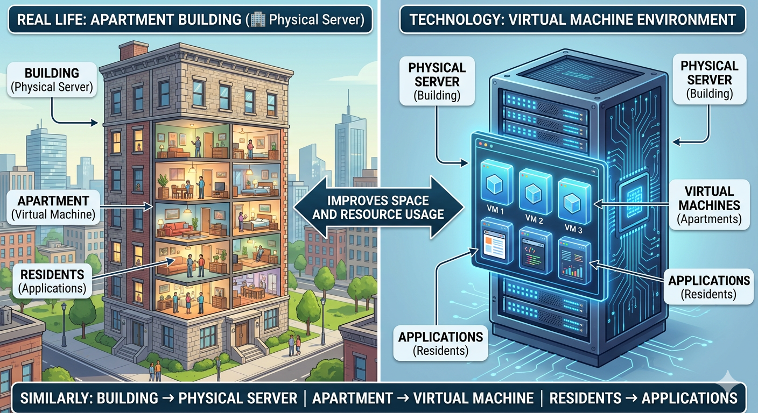
CONCEPT INTRODUCTION
Why Virtualization?
The Old Way
Example: Apartment Building
One application = One physical server
Expensive hardware
Massive resource wastage
Hard to scale
The Modern Need
Run multiple applications
Use resources efficiently
Reduce cost
Solution: Virtualization
3

Slide 4
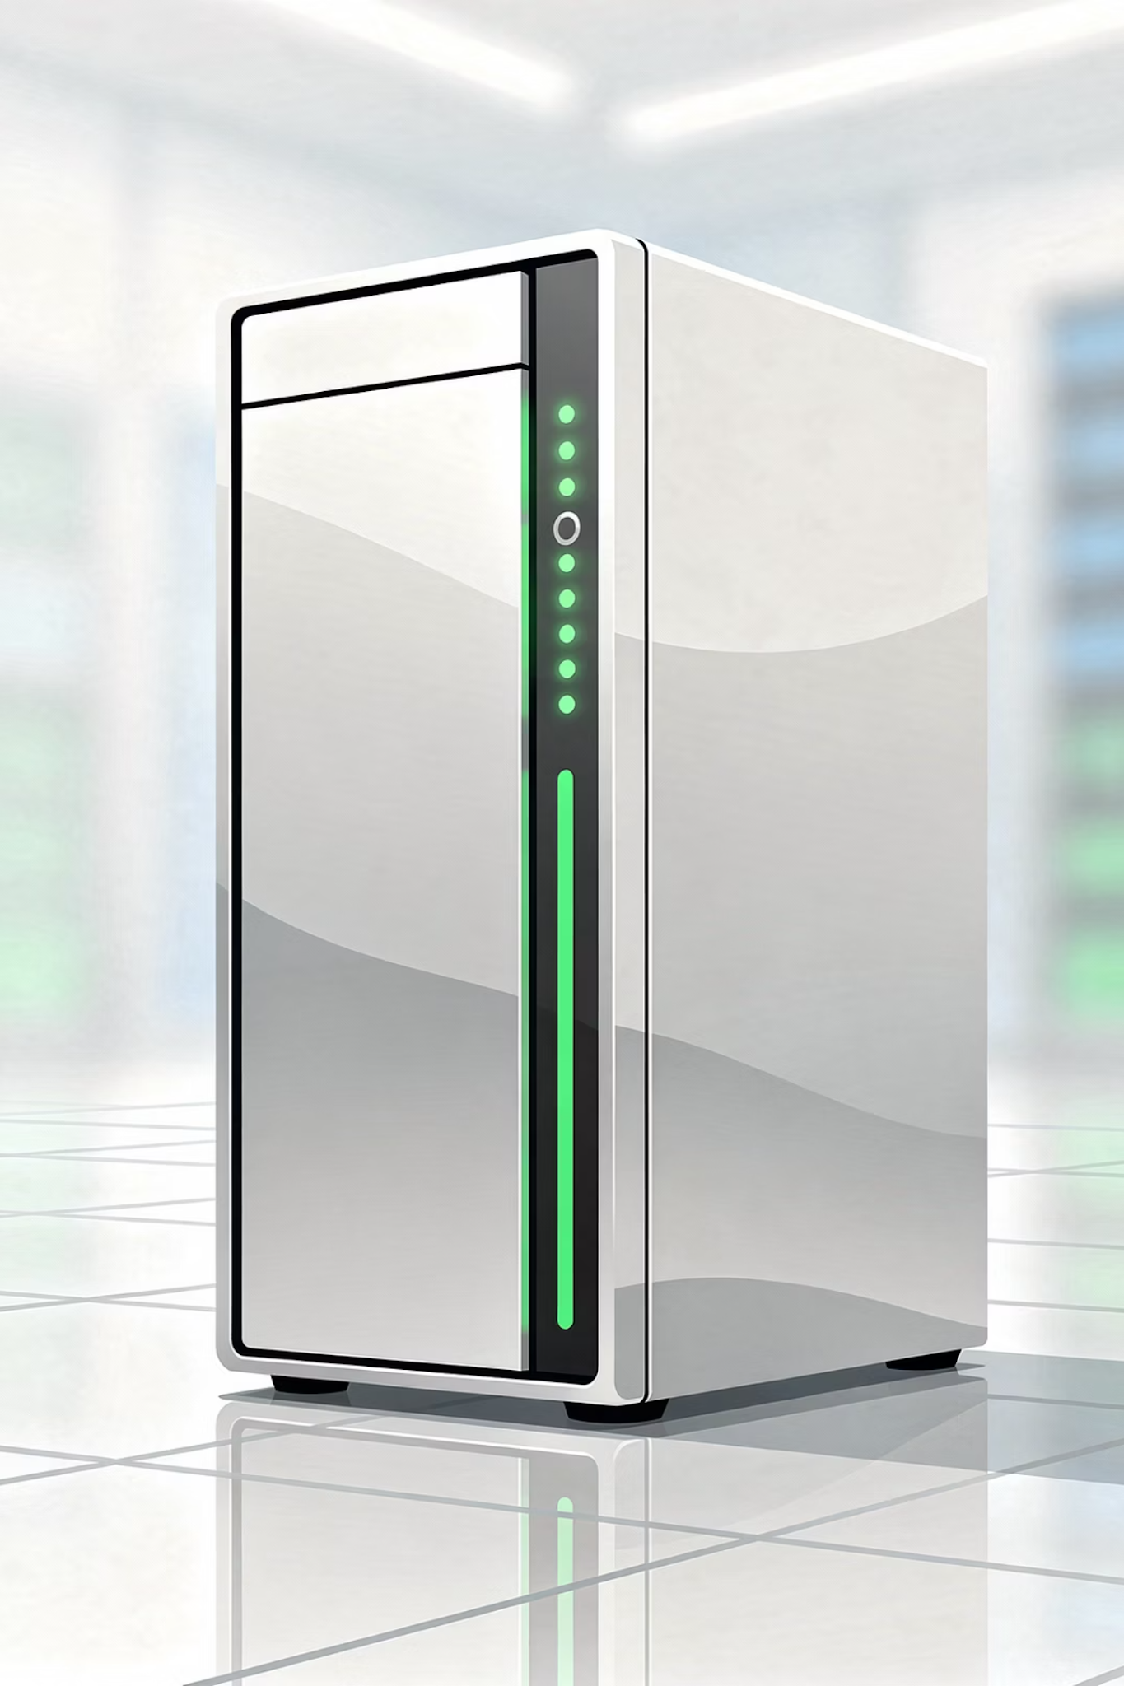

PHYSICAL VS VIRTUAL SERVERS
Physical Server
What It Is
Problems
Actual hardware machine with CPU, RAM, and storage running a single OS.
Underutilization, expensive hardware, and slow scaling.
4

Slide 5

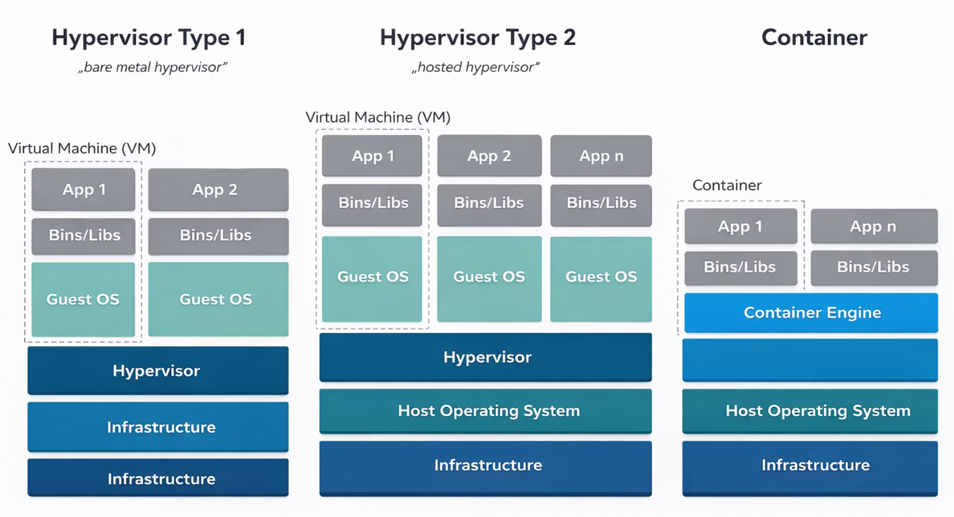
PHYSICAL VS VIRTUAL SERVERS
Virtual Server (VM)
What It Is ?
Software-based server.
Runs on physical machine
Multiple VMs on one server
Benefits:
Better resource usage
Isolation between VMs
Easier scaling
5

Slide 6
COMPARISON
Physical vs Virtual Comparison
Feature
Physical Server
Virtual Server
Operating System
One OS
Multiple OS
Dependency
Hardware dependent
Software-defined
Scaling
Expensive scaling
Easy scaling
Utilization
Low utilization
High utilization
6

Slide 7

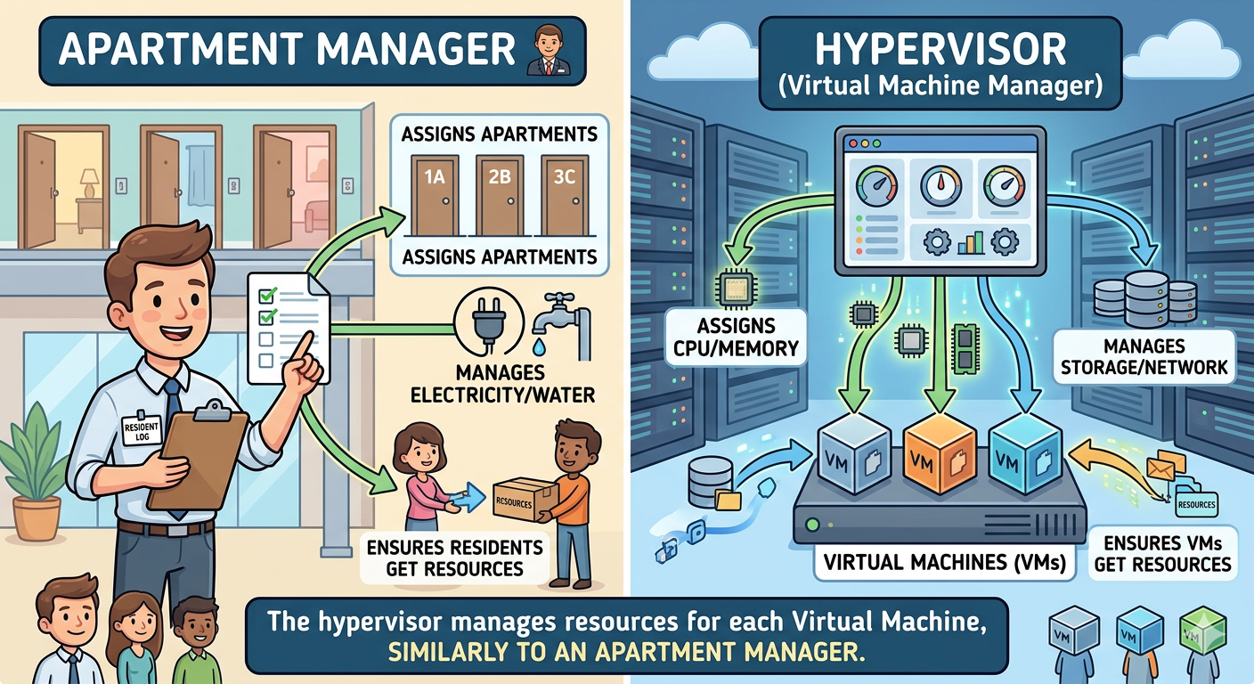
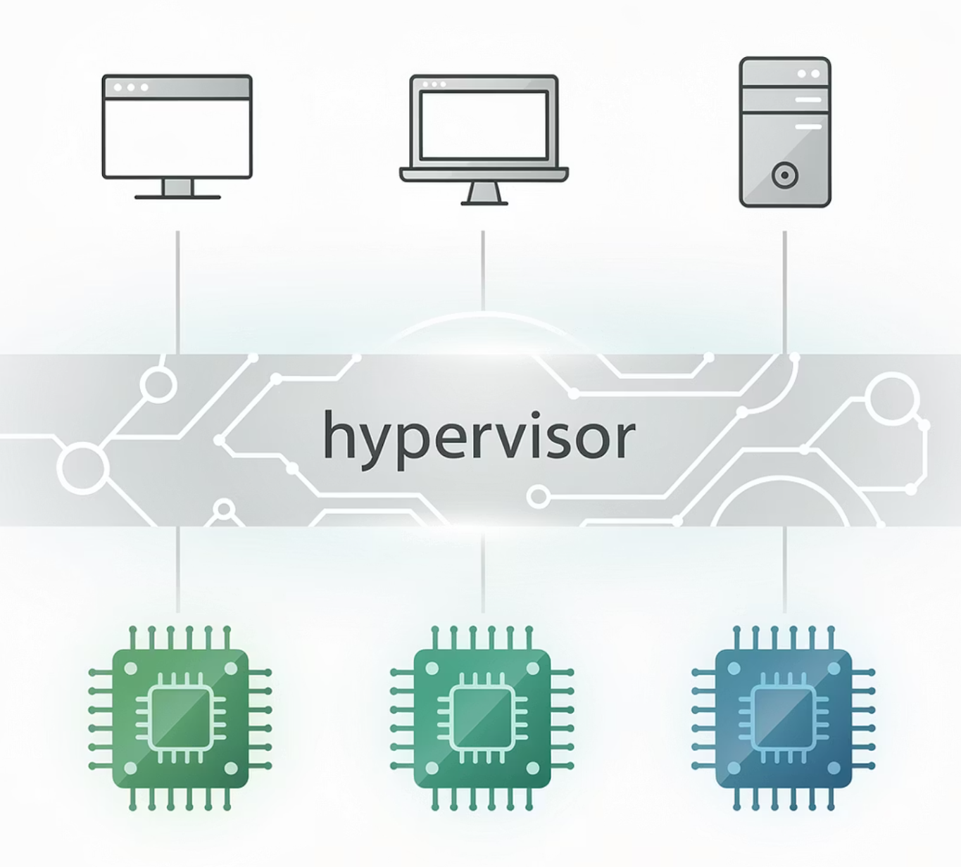
WHAT IS A HYPERVISOR?
What is a Hypervisor?
Software that creates and manages Virtual Machines.
It divides physical resources and allocates CPU, RAM, and storage.
It sits between the hardware and the virtual machines.
Example: Apartment Manager
7

Slide 8
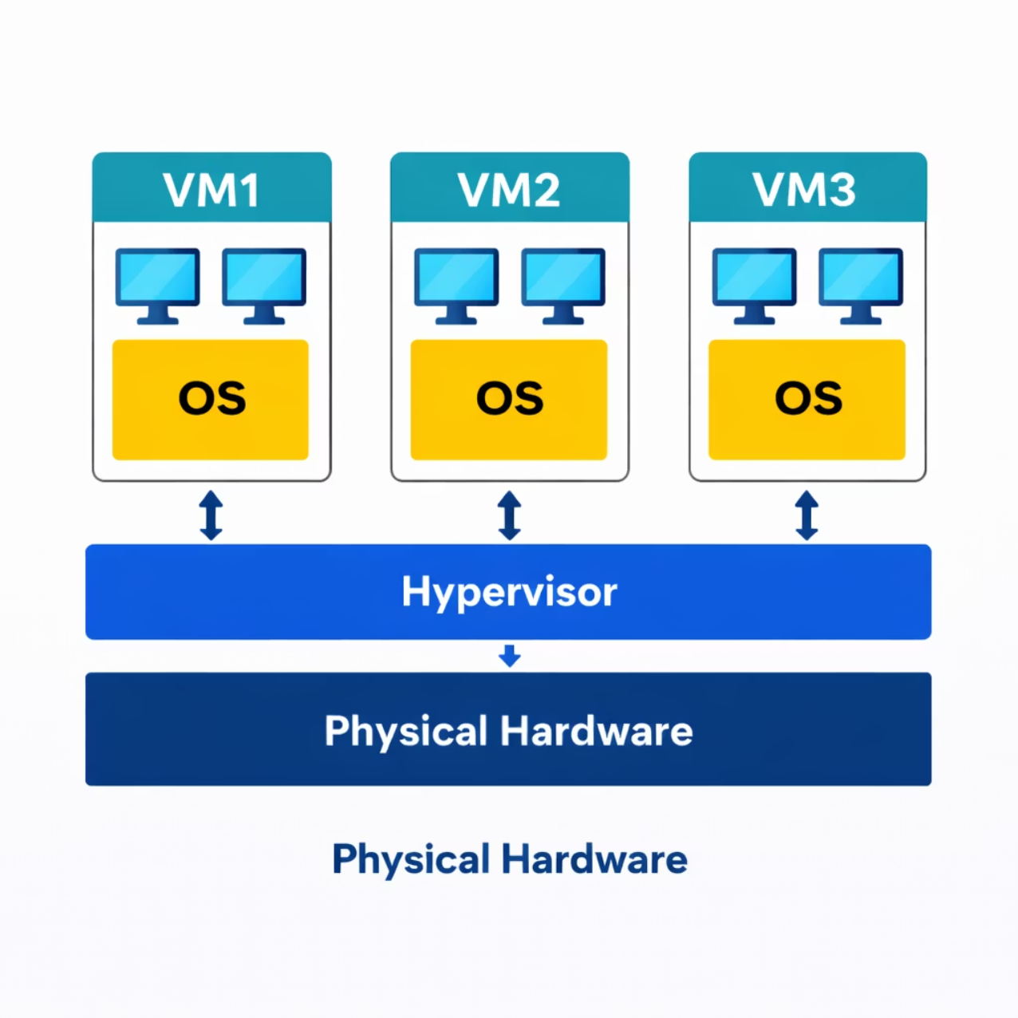
HYPERVISOR
Hypervisor Architecture
The hypervisor abstracts physical resources and distributes them across isolated virtual machines, each running its own operating system.
8

Slide 9
Quiz Time
Q1. What is Virtualization?
✅ Answer: Virtualization is the technology that allows multiple virtual systems to run on a single physical computer.
Q2. What is a Hypervisor?
✅ Answer: A hypervisor is software that creates and manages virtual machines.
Q3. Difference between Type-1 and Type-2 Hypervisor?
✅ Answer:
Type
Description
Example
Type-1
Runs directly on hardware
VMware ESXi
Type-2
Runs on operating system
Oracle VM VirtualBox
9

Slide 10
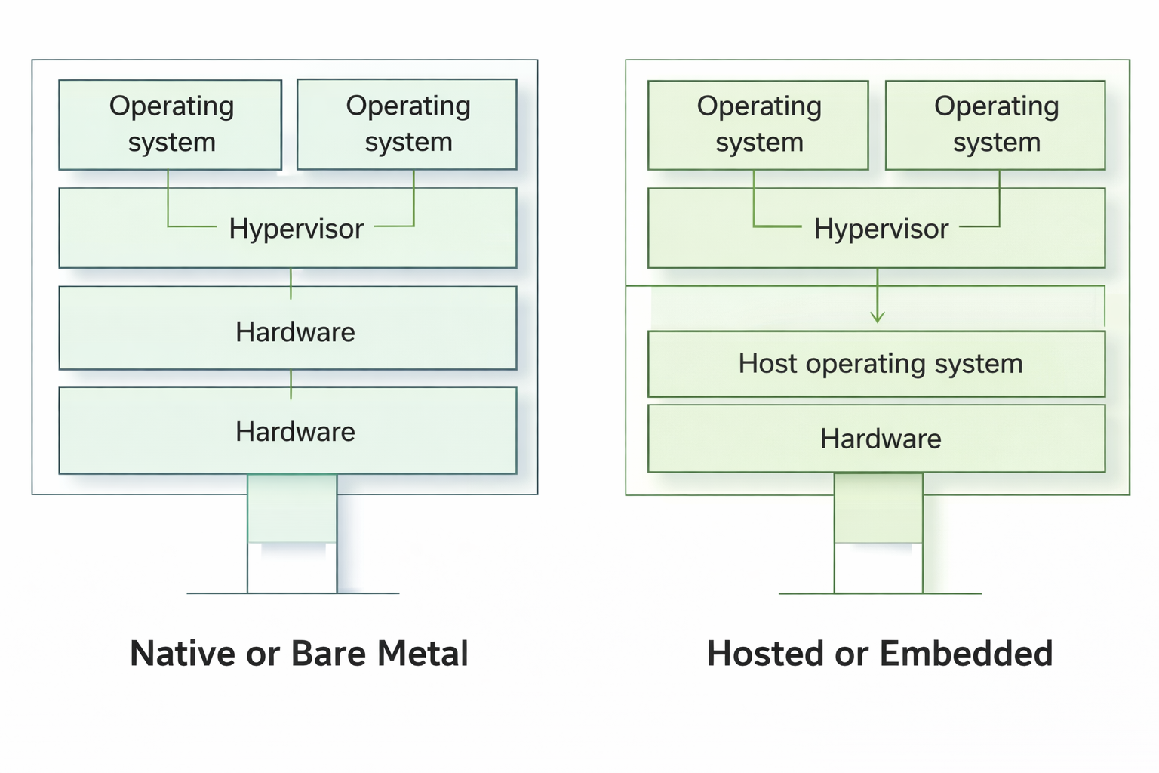
HYPERVISOR TYPES
Types of Hypervisors
1
Type 1 — Bare Metal
2
Type 2 — Hosted
Runs directly on hardware for high performance.
Runs on top of an existing OS, used for testing.
Examples: VMware ESXi, Microsoft Hyper-V
Example: VirtualBox
10

Slide 11

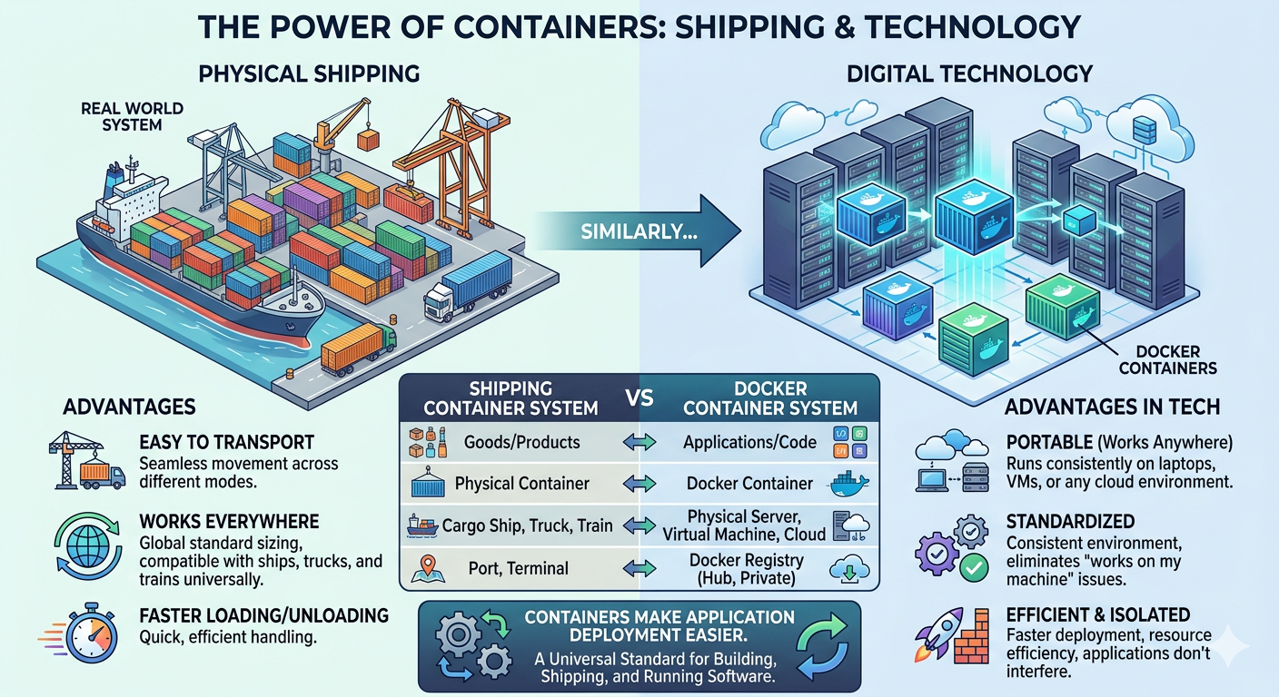
WHAT IS CONTAINERIZATION?
What is Containerization?
Example: Shipping Containers
Lightweight Virtualization
Packages application + dependencies together.
Shared OS
Runs on the host operating system kernel.
Popular Tool
Docker is the leading containerization platform.
11

Slide 12
Quiz Time
Q1. What is Virtual CPU (vCPU)?
✅ Answer: vCPU is a virtual processor given to a virtual machine from the physical CPU.
Example: If a computer has 8 cores, you can assign 2 cores to a VM.
Q2. What is Virtual Memory?
✅ Answer: Virtual memory is RAM assigned to a virtual machine.
Example: A VM can be given 4GB RAM from the host computer.
Q3. What is Virtual Network?
✅ Answer: Virtual networking allows virtual machines to connect with each other and the internet.
Example: In Oracle VM VirtualBox, VMs can communicate using a virtual network adapter.
12

Slide 13
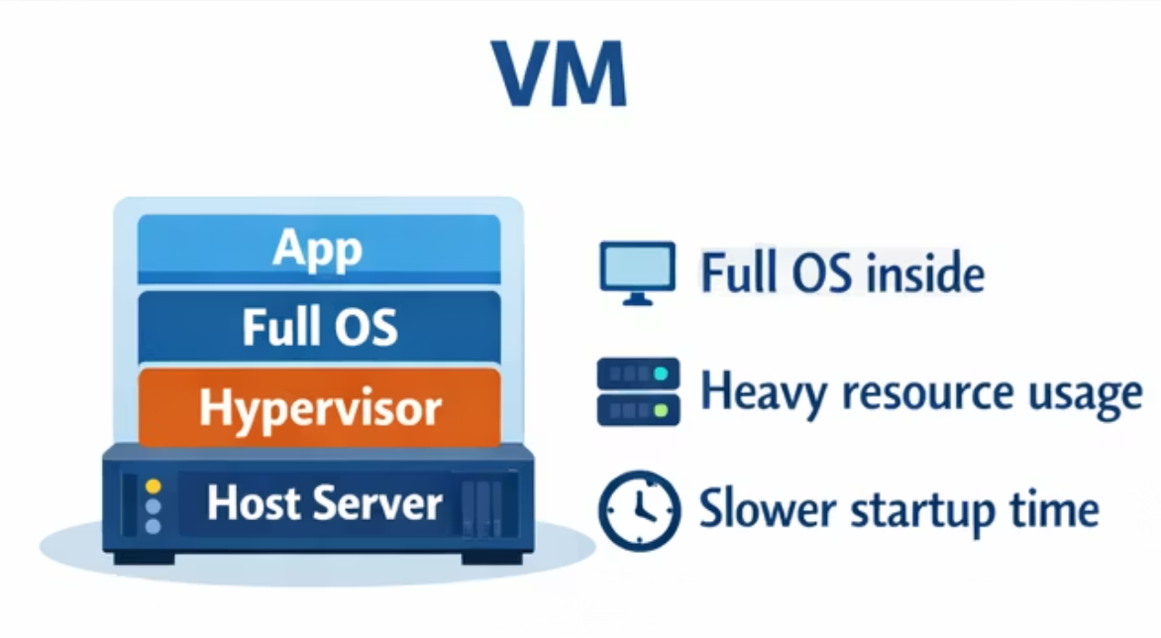
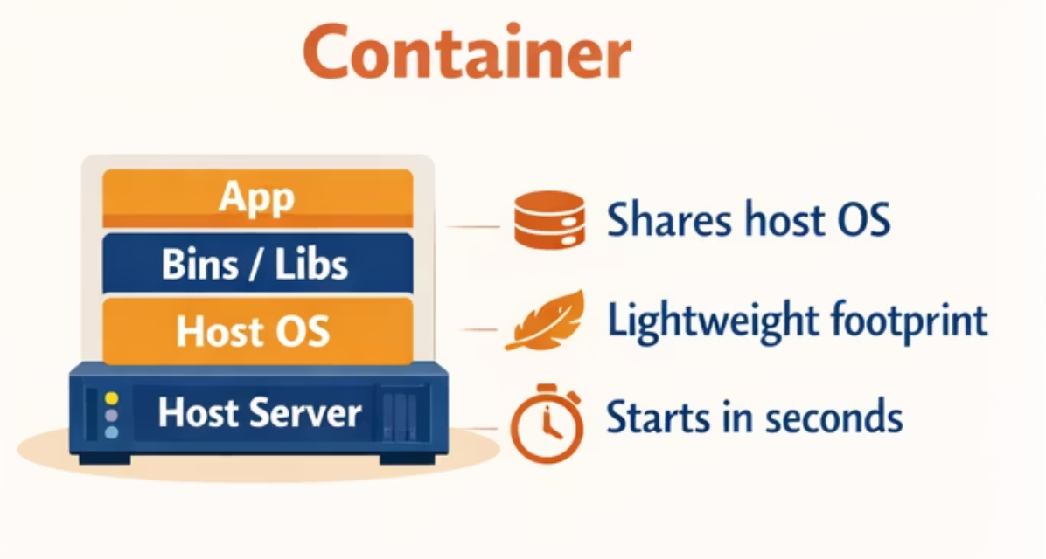
VM VS CONTAINER
VM vs Container: Basic Idea
When to Use a VM?
When to Use a Container?
Different OS required
Strong isolation needed
Legacy applications
Microservices
Fast deployment
Cloud-native apps
CI/CD pipelines
13

Slide 14
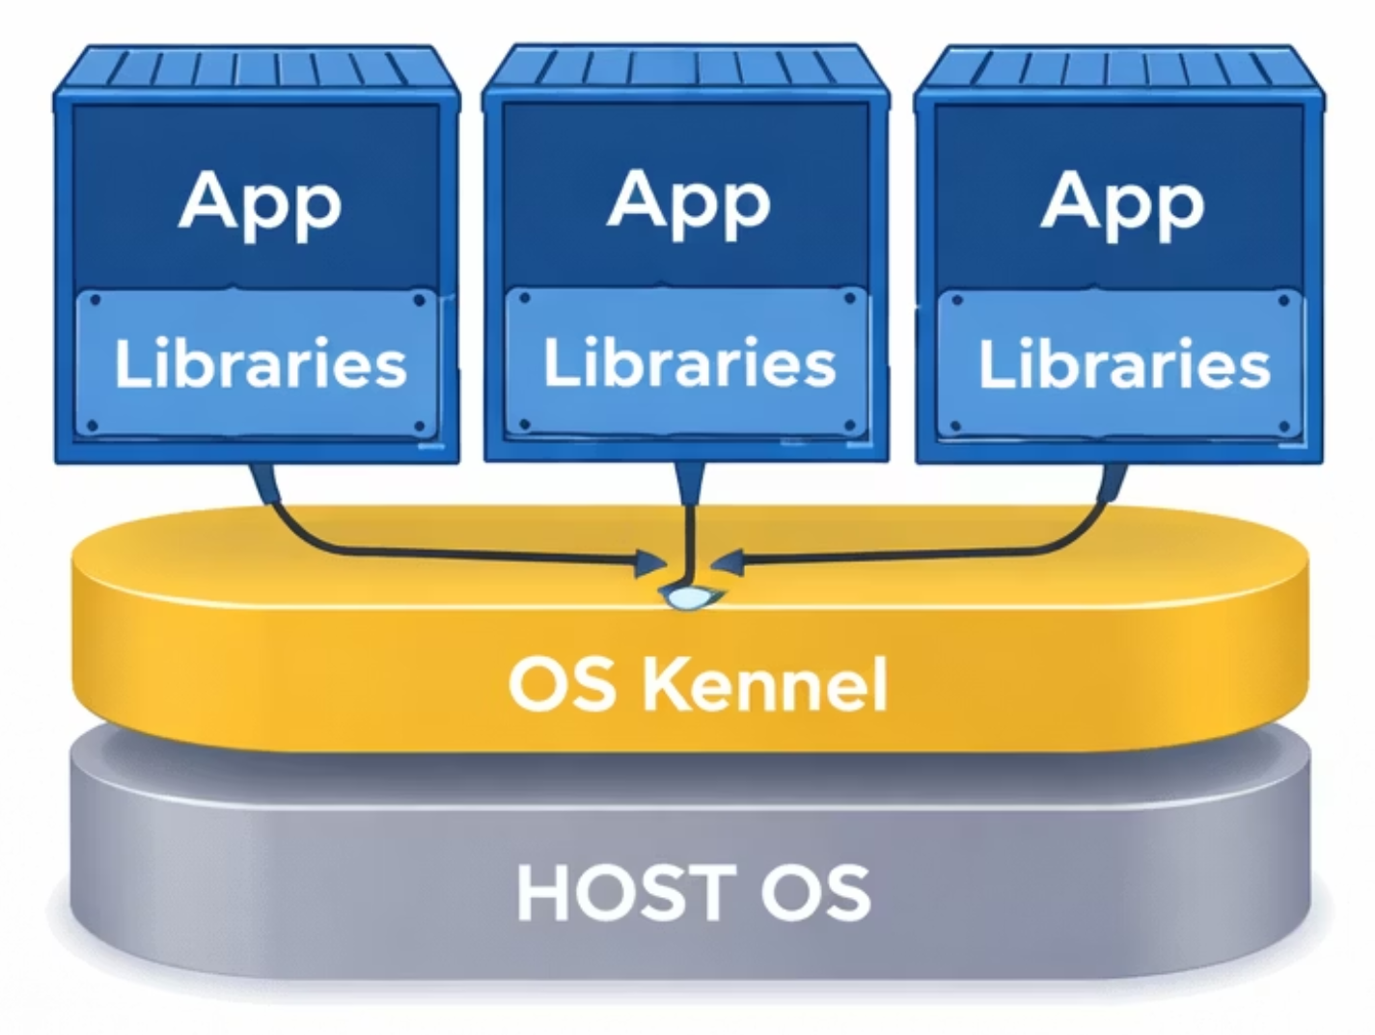
SHARED OS
Shared OS Concept
How It Works
All containers share the same OS kernel.
Only the app and its libraries are isolated.
This makes containers:
Fast — instant startup
Efficient — minimal overhead
Small — lightweight footprint
14

Slide 15

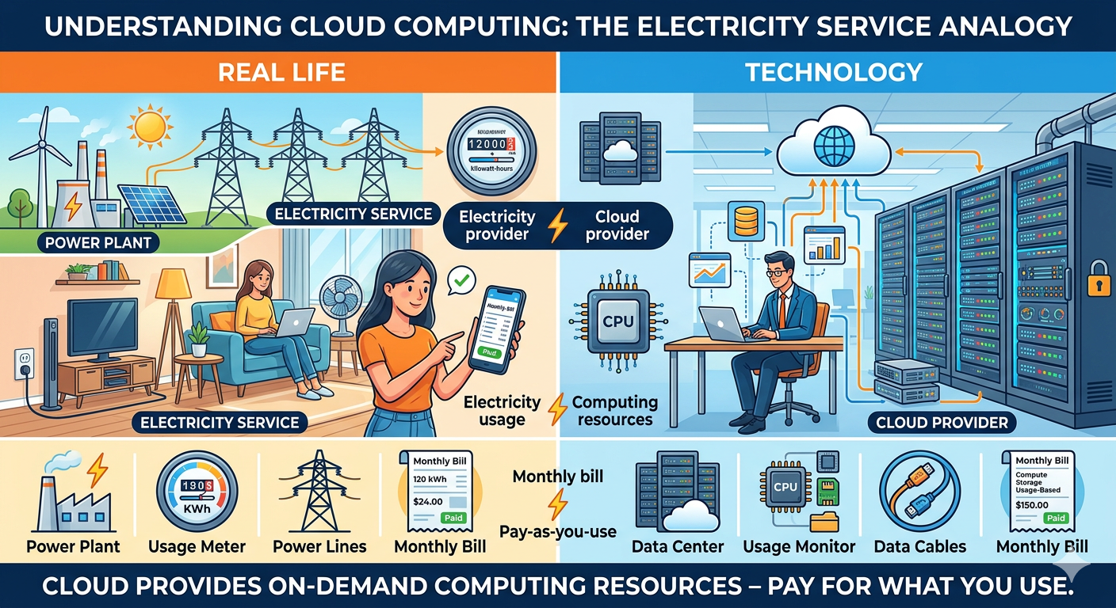
REAL-WORLD EXAMPLES
Hosting Multiple Websites
Example: Electricity Service
One company hosting Website A, B, and C — instead of 3 physical servers, use 3 VMs or 3 Containers on 1 server.
1
3
66%
Server Needed
Websites Hosted
Cost Reduction
15

Slide 16
Quiz Time
Q1. What is Cloud Computing?
✅ Answer: Cloud computing means using servers, storage, and software through the internet instead of using your own computer or local server.
Example: Companies host their applications on Amazon Web Services instead of buying their own servers.
Q2. What is an example of a Cloud Service?
✅ Answer: A cloud service is an application or platform that works through the internet.
Example: People store files online using Google Drive instead of saving everything on their computer.
Q3. What is one benefit of Cloud Computing?
✅ Answer: Cloud computing helps save cost and scale resources easily.
Example: A startup can launch its website on Microsoft Azure without buying expensive hardware.
16

Slide 17

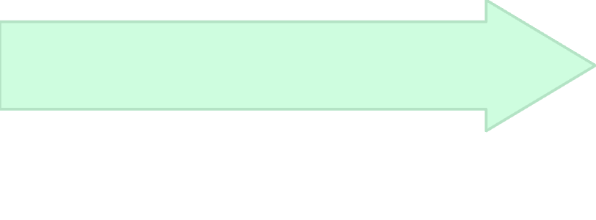

REAL-WORLD EXAMPLES
Startup Scaling Scenario
Containers + Cloud
Virtualization
Spin up replicas, auto-scale on demand
Growth
Add more VMs to handle load
Launch
1 million users → Need scaling
100 users → 1 server is enough
17

Slide 18


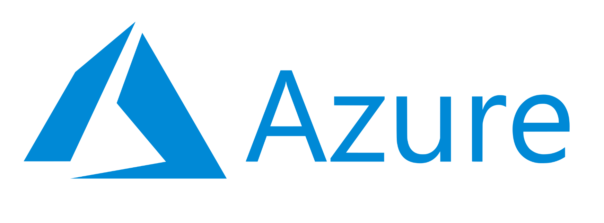
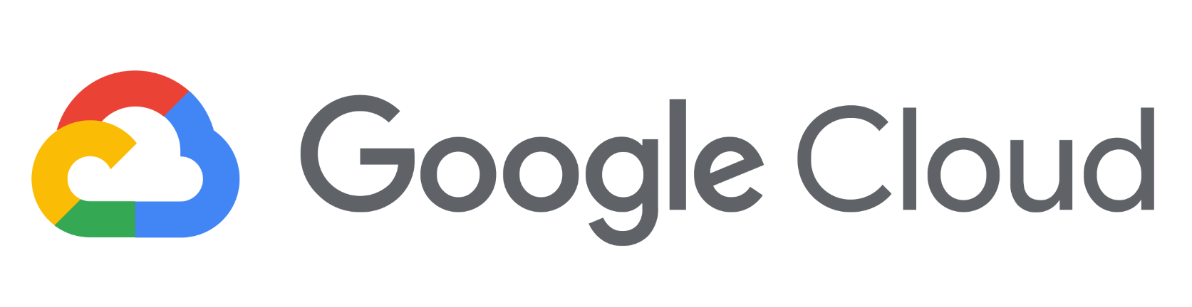
CLOUD INTRODUCTION
What is Cloud Computing?
Cloud = On-demand computing resources over the internet. Instead of buying servers, rent from cloud providers.
Amazon Web Services
Microsoft Azure
Google Cloud Platform
18

Slide 19





Why Cloud?
No Hardware Management
Pay As You Use
Focus on your app, not your servers.
Only pay for the resources you consume.
Global Data Centers
Auto Scaling
Deploy close to your users worldwide.
Scale up or down automatically with demand.
Cloud + Virtualization + Containers = Modern Infrastructure
19

Slide 20
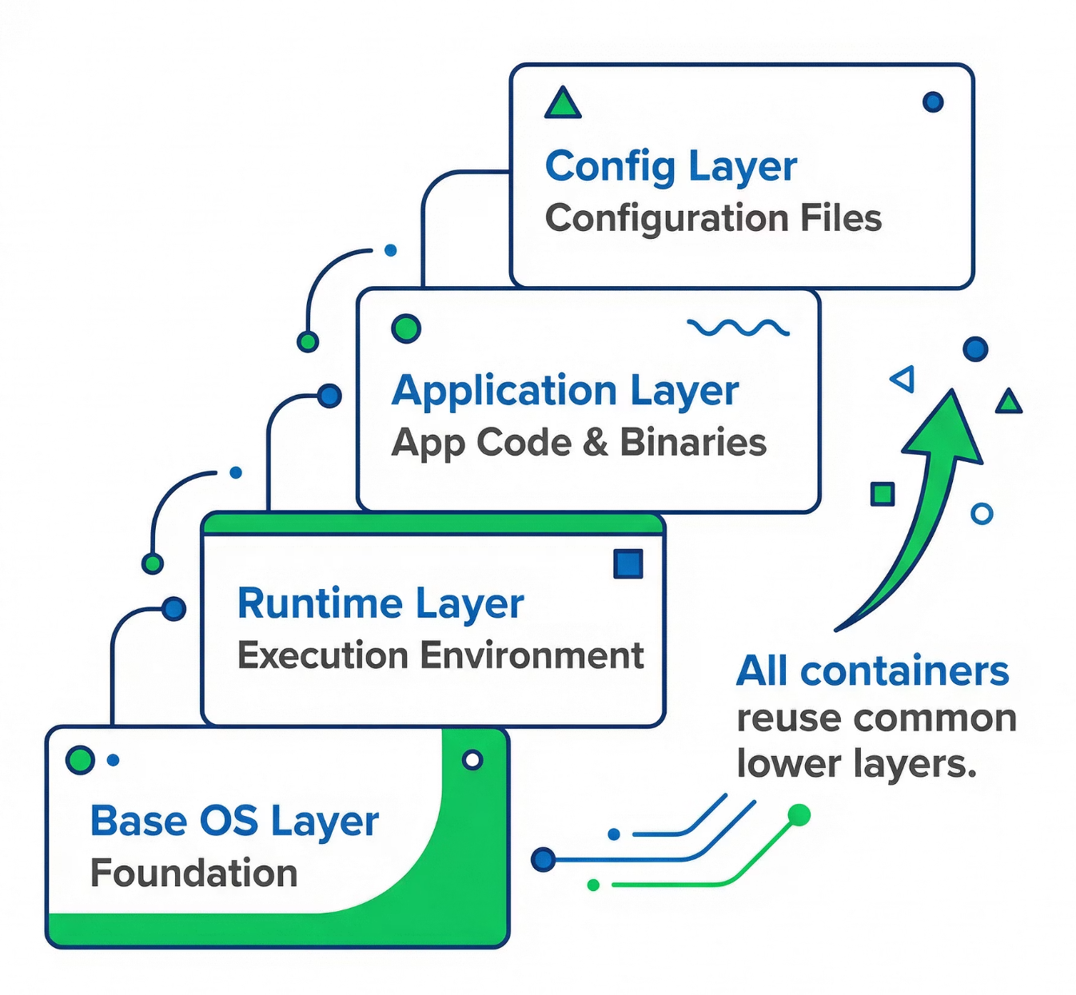
ARCHITECTURE
Container Image Layers
Layered Architecture
Container images are built in layers:
Base OS Layer
Runtime Layer
Config Layer
Application Layer
All containers reuse common layers, saving storage and speeding up deployment.
20

Slide 21
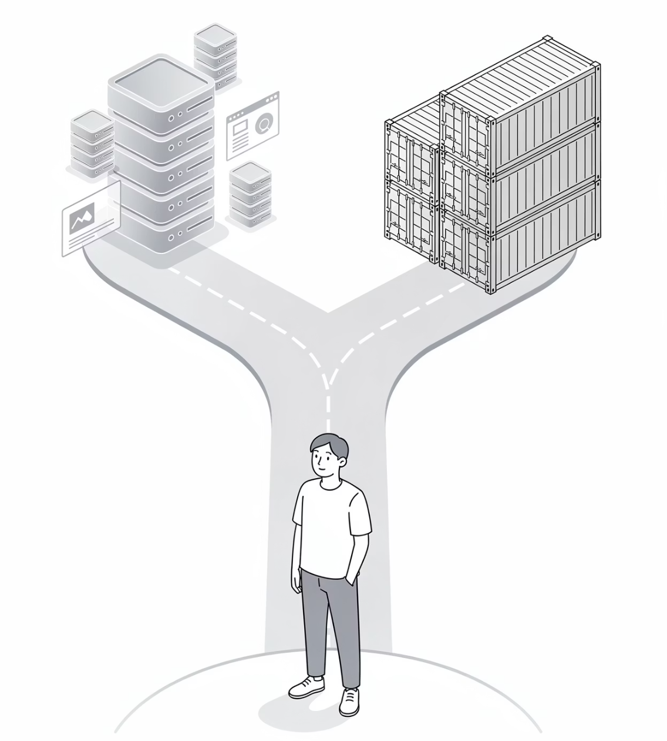
SCENARIO DISCUSSION
VM vs Container?
Use a VM When?
1
Different OS required
Strong isolation needed
Legacy applications
When to Use a Container?
Microservices architecture
Fast deployment needed
Cloud-native apps
CI/CD pipelines
2
21

Slide 22

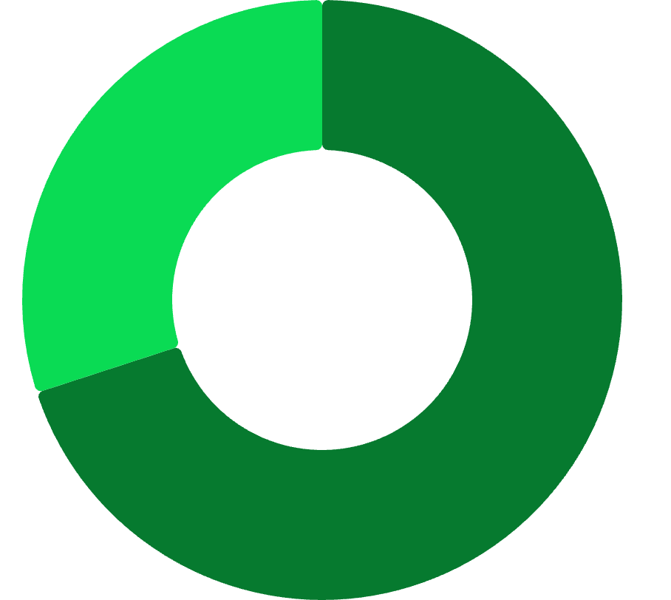


COST ANALYSIS
Which is More Cost-Effective?
It Depends on the Use Case
VMs: More resources required, higher cost.
Virtual Machine·70%
Containers: Lightweight, better resource utilization, lower cost at large scale.
Container·30%
The right choice depends on your specific workload and isolation requirements.
22

Slide 23
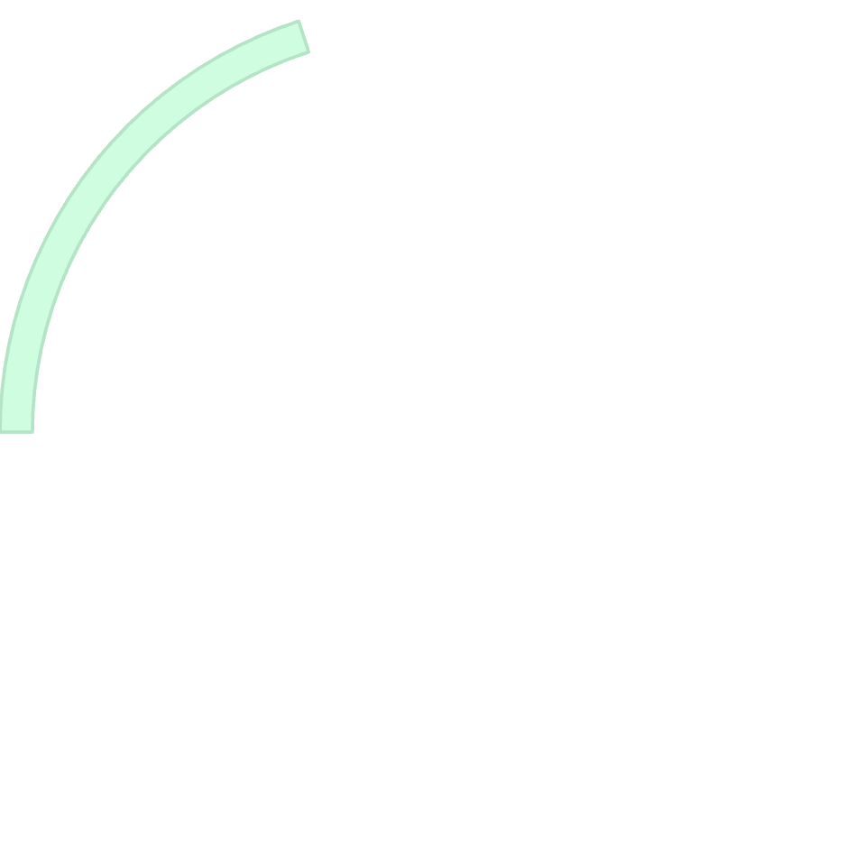
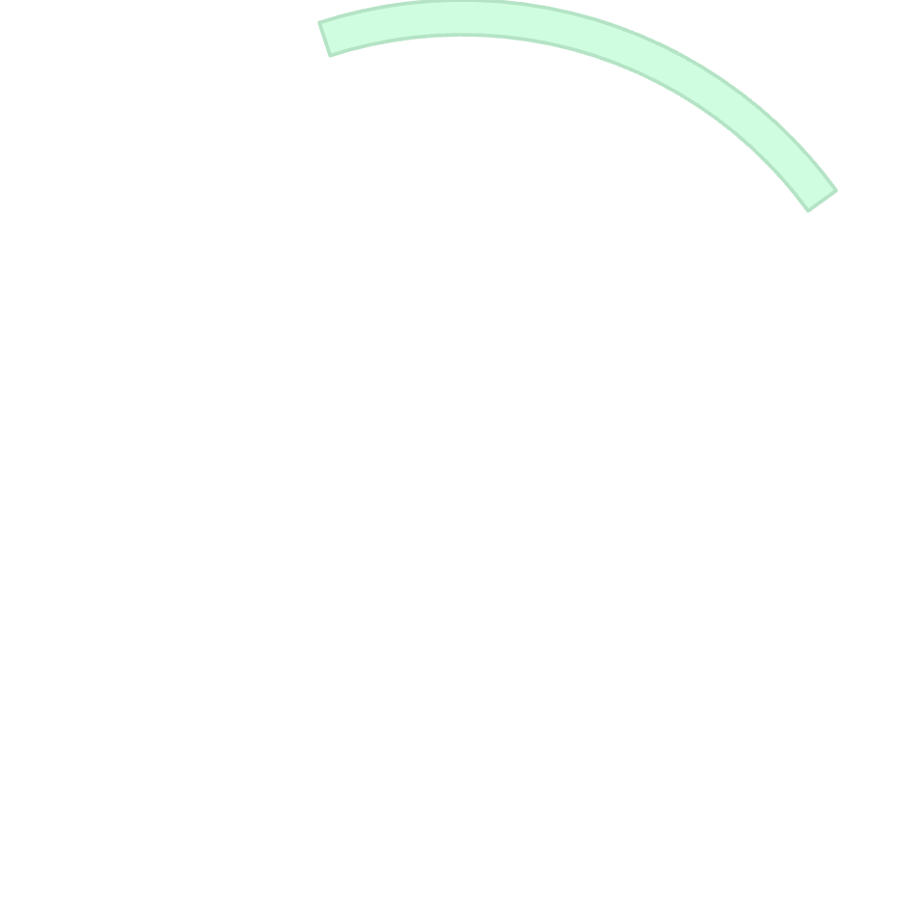


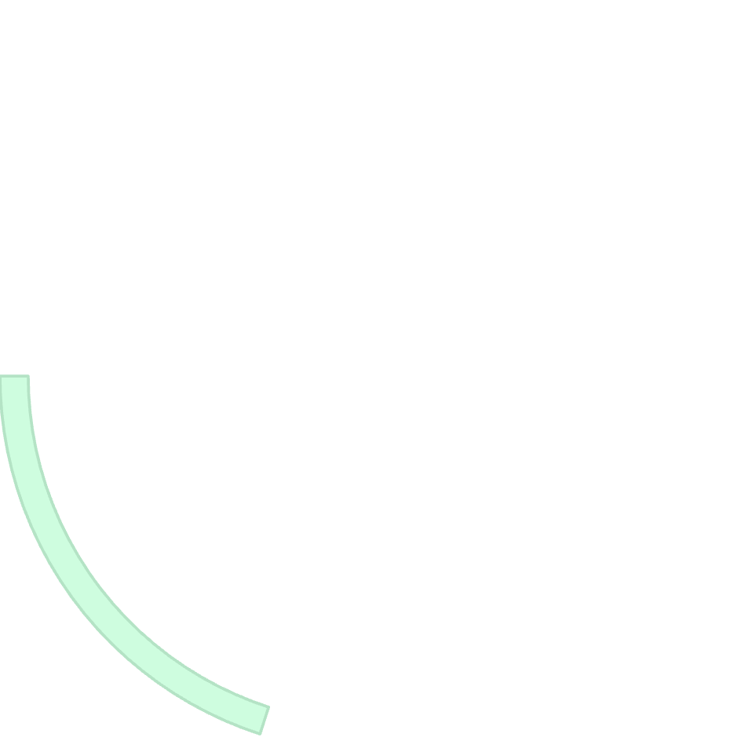





MODERN ARCHITECTURE
Modern Production Architecture
Virtual Machines
Cloud Provider
Container Runtime
Application
Containers
This layered approach delivers flexibility + scalability + cost efficiency — the foundation of today's production systems.
23

Slide 24
Discussion Questions
1
Can containers run without VMs?
2
Why do big companies use containers?
3
Is Docker replacing VMs?
4
What happens if the host OS crashes?
5
Which is safer: VM or Container?
24

Slide 25




SUMMARY
Key Takeaways
Physical vs Virtual
Hypervisors
VMs maximize hardware utilization
Type 1 (bare metal) vs Type 2 (hosted)
Containers
Cloud + Scale
Lightweight, shared OS, fast startup
Auto-scaling modern infrastructure
Cloud + Virtualization + Containers form the backbone of modern infrastructure — delivering flexibility, scalability, and cost efficiency.
25

Slide 26

Thank You
26

